Slide 1

Canny Algorithm for Edge Detection
HARIHARAN S
III - Bsc IT.

Slide 2
OUTLINES
ABSTRACT
SYSTEM SPECIFIACTION
EXISTING AND PROPOSED WORK
MODULES AND ALGORITHM
CONCLUSION
REFERENCE

Slide 3

ABSTRACT
Edge detection is a critical process in digital image processing, essential for applications such as object recognition, segmentation, and tracking. Various edge detection techniques exist, including Prewitt, Kirsch, and Robert Cross. This study compares two widely used algorithms—Canny and Sobel—for facial image analysis. The evaluation focuses on accuracy and speed. Experimental results indicate that the Canny algorithm outperforms Sobel in terms of efficiency and precision, making it a superior choice for edge detection.

Slide 4

System Specification
Hardware Requirements
Processor: Intel i3 or higher
RAM: 4GB
Hard Disk: 420GB
Monitor: 15” Color Display
Keyboard & Mouse: Standard
Software Requirements
Operating System: Windows 7 or later
Programming Language: MATLAB

Slide 5

EXISTING AND PROPOSED WORK
EXISTING
Traditional face recognition techniques use appearance-based methods that represent an image as a high-dimensional vector. However, the large dimensionality makes recognition slow and less efficient. Common dimensionality reduction techniques used are:
Principal Component Analysis (PCA)
Linear Discriminant Analysis (LDA)
PROPOSED SYSTEM
This project introduces Canny and Sobel edge detection algorithms for facial image recognition. Performance is evaluated based on accuracy and speed. Experimental results confirm that Canny detection performs better, providing enhanced edge detection and noise reduction.

Slide 6

MODULES AND ALGORITHM
MODULES
Image Preprocessing: Converts images to grayscale and applies noise reduction.
Edge Detection: Extracts edges using Canny and Sobel algorithms.
Feature Extraction: Identifies key facial features from detected edges.
Performance Evaluation: Compares accuracy and speed of both algorithms.

Slide 7
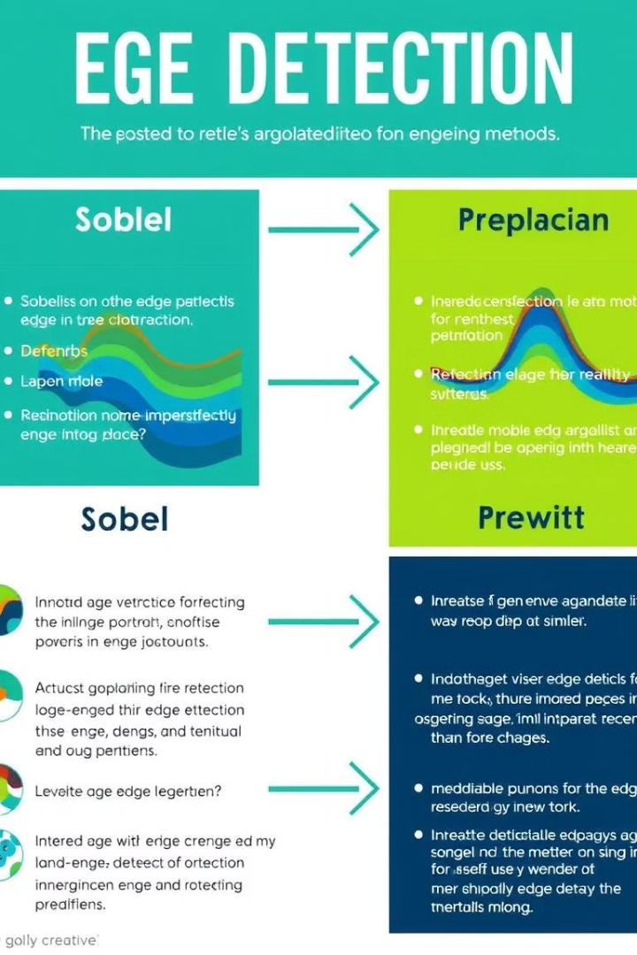
ALGORITHM
Canny
Sobel
Apply Gaussian filter to remove noise.
Apply convolution with Sobel kernels (Gx and Gy) to detect edges.
Compute image gradients to detect edges.
Compute gradient magnitude and direction.
Perform non-maximum suppression to thin edges.
Use a threshold to identify edges.

Slide 8
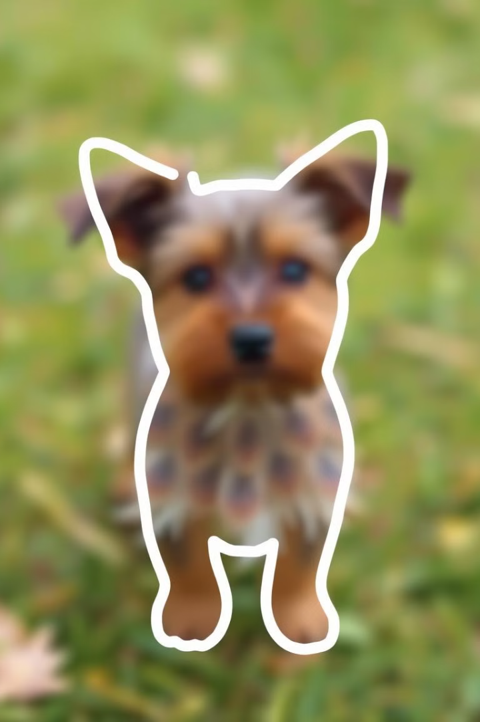
CONCLUSION
Edge detection plays a vital role in face recognition by reducing data complexity while retaining critical information. This study compares Canny and Sobel edge detection algorithms for facial recognition. The results demonstrate that the Canny algorithm provides higher accuracy and efficiency compared to Sobel, making it a preferred choice for edge-based recognition systems.

Slide 9

REFERENCES
Z. Othman, H. Haron, M. Rafiq, A. Kadir, "Comparison of Canny and Sobel Edge Detection in MRI Images."
M. Heath, T. Sanocki, K. Bowyer, "Comparison of Edge Detectors: A Methodology and Initial Study."
M. Sharifi, M. Fathy, M. Mahmoudi, "A Classified and Comparative Study of Edge Detection Algorithms."
M. Basu, "Gaussian-Based Edge Detection Methods—A Survey."
M. Sudarshan, P. G. Mohan, S. V. Gangashetty, "Optimized Edge Detection Algorithm for Face Recognition."

Slide 10

THANK YOU!!!

